Slide 1
Session 16
Aggregation in Java

Slide 2
Outcomes
Reusability- After learning Aggregation in Java, the learner would know about code reusability.
Accessibility between two classes.
Program size will be decreased and performance of the program will be improved.

Slide 3
Agenda
What is Aggregation?
Aggregation can be defined as the relationship between two classes.
Aggregation is a special form of association.
Its a directional association, which means it is strictly a one way association.
It represents a HAS-A relationship.

Slide 4
Agenda
What is Aggregation?
STUDENT
HAS-A
ADDRESS
Every student has an address so the relationship between student and address is a Has-A relationship.

Slide 5
Example Problem
Write a Java program to enforce the notion of aggregation. Two classes are open. The first name of the class is the address and the second name of the class is the student. The Student class is combined with the Address class, so the Address class can be reached by the Student class.

Slide 6
Example Problem
class Address
{
int streetNum;
String city;
String state;
String country;
Address(int street, String c, String st, String coun)//constructor in Address class
{
this.streetNum=street;
this.city =c;
this.state = st;
this.country = coun;
}
}

Slide 7
Example Problem
class StudentClass
{
int rollNum;
String studentName;
//Creating HAS-A relationship with Address class
Address studentAddr;
StudentClass(int roll, String name, Address addr){ // constructor of StudentClass
this.rollNum=roll;
this.studentName=name;
this.studentAddr = addr;
}
public static void main(String args[]){
Address ad = new Address(55, "Agra", "UP", "India");
StudentClass obj = new StudentClass(123, “Raina", ad);
System.out.println(obj.rollNum);
System.out.println(obj.studentName);
System.out.println(obj.studentAddr.streetNum);
System.out.println(obj.studentAddr.city);
System.out.println(obj.studentAddr.state);
System.out.println(obj.studentAddr.country);
}
}

Slide 8
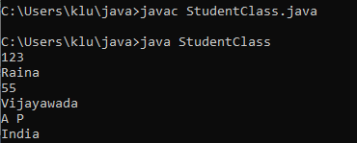
Example Problem

Slide 9
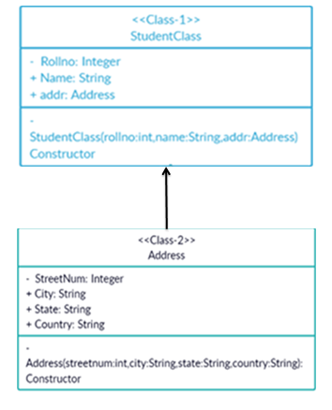
Class Diagram

Slide 10
Quiz
In Java, aggregation is a(n) _____ relationship between classes.
a) One-Way b) Inherited c) Two Way d) Invalid
2. In object oriented programming, composition relates to
(a) The use of consistent coding conventions (b) The organization of components interacting to achieve a coherent, common behavior (c) The use of inheritance to achieve polymorphic behavior (d) The organization of components interacting not to achieve a coherent common behavior (e) The use of data hiding to achieve polymorphic behavior.

Slide 11
Quiz
3. What is it called where object has its own lifecycle and child object cannot belong to another parent object?
a. Aggregation
b. Composition
c. Encapsulation
d. Association

Slide 12
Quiz
4. Aggregation is which of the following?
A. Expresses a part-of relationship and is a stronger form of an association relationship.
B. Expresses a part-of relationship and is a weaker form of an association relationship.
C. Expresses an is-a relationship and is a stronger form of an association relationship.
D. Expresses an is-a relationship and is a weaker form of an association relationship.

Slide 13
Quiz
5. What is an aggregate?
A. An object with only primitive attributes.
B. An instance of a class which has only static methods.
C. An instance which has other objects.
D. None of the above.

Slide 14
Recap
Definition of Aggregation
Example
Class Diagram
Quiz

Slide 15
Thank You

